Slide 1














WELCOME
MD. SHOHANUR RAHMAN SHOHAN
22-46013-1
MD. SABBIR SIKDER
22-46005-1
MD. TANVIR RAHMAN MOLLA
22-46052-1
MD. ABRAR SHAHRIYAR
22-46049-1

Slide 2
Impact Of E-Commerce On Food Business
Course Name : ENGLISH READING SKILLS & PUBLIC SPEAKING
Course Teacher : KASPIA SULTANA
Assistant Professor
American International University-Bangladesh (AIUB)

Slide 3
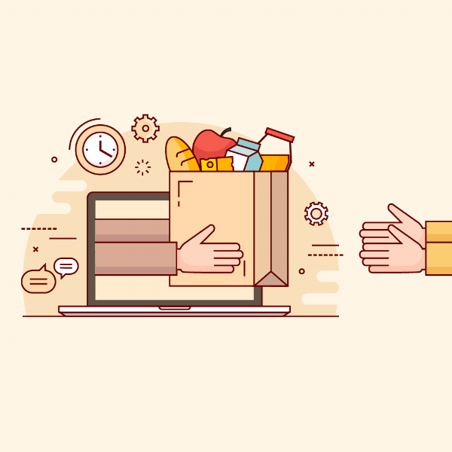
What is E-Commerce?
E-commerce stands for electronic commerce and refers to a digital platform and a business model where we can buy or sell products online. Every time we purchase a product online, we’re participating in the e-commerce economy.

Slide 4
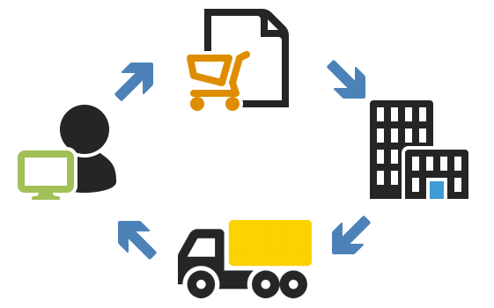
How does E-Commerce Work?
E-commerce works on the same principles as a physical store. Customers come into an e-commerce store, browse products and make a purchase. The big difference is they don't have to get off their couch to do so, and the customer base isn't limited to a specific geographic area or region.

Slide 5


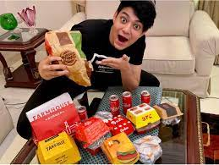

How to Market Your E-Commerce Food Business
With Social Media Targeting.
Publish Dynamic Content.
Using the power of social influencer.
By Creating an Awesome Blog.

Slide 6

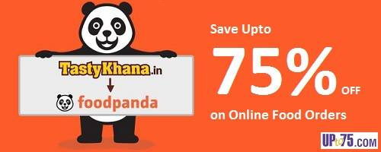
Advantages of E-commerce on Food Business
Cost Reduction.

Slide 7



Advantages of E-commerce on Food Business
Spread of Business.

Slide 8
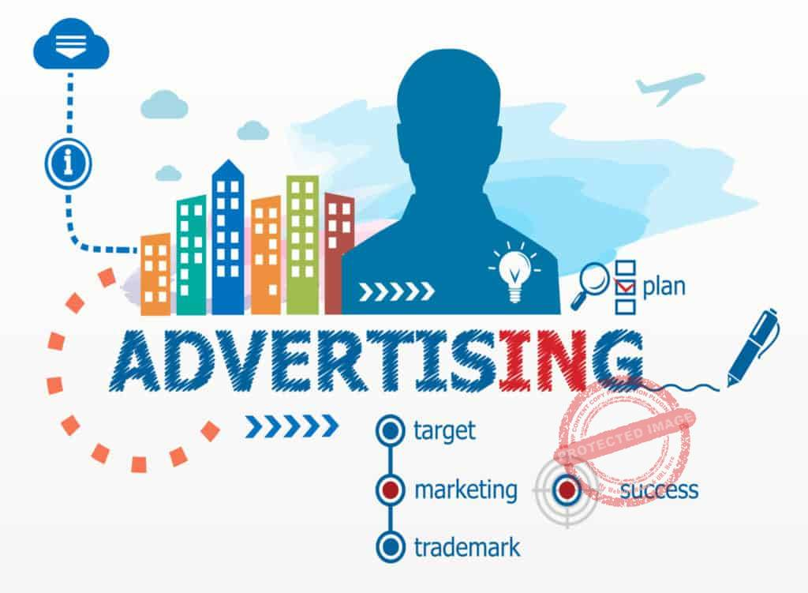
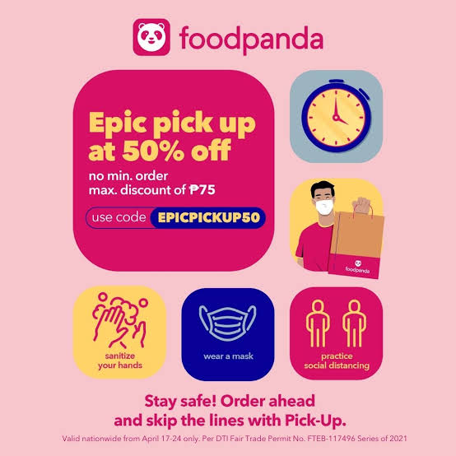
Advantages of E-commerce on Food Business
Effective Advertisement.

Slide 9


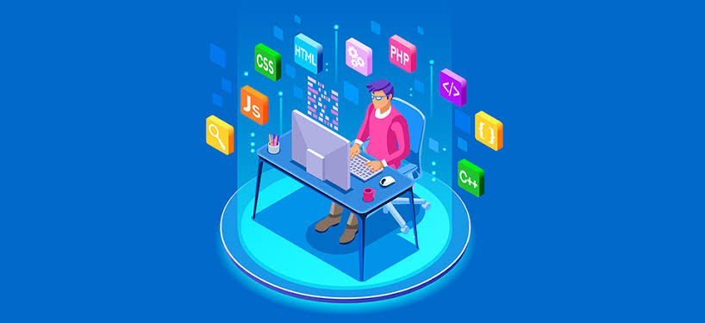
Advantages of E-commerce on Food Business
Reducing Unemployment Problem.

Slide 10

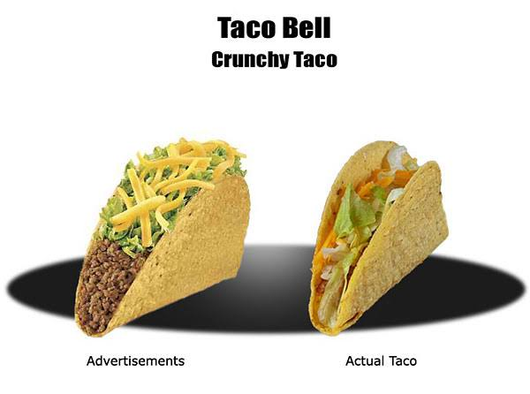
Disadvantages of E-commerce on Food Business
No Possibility of Tried & Tasted The Product.
Sometimes Customers Get Cheated

Slide 11
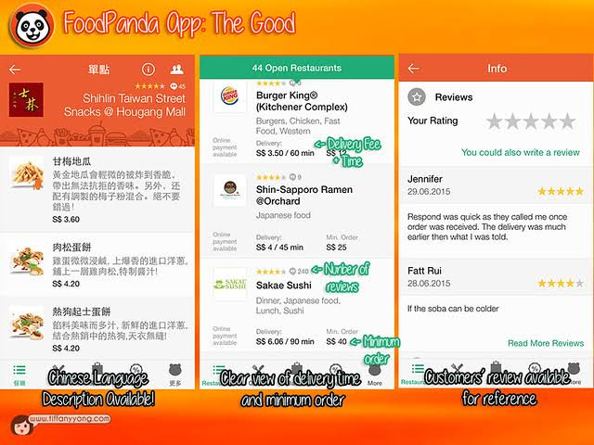
Disadvantages of E-commerce on Food Business
Solutions.
Solutions

Slide 12
Conclusion
Apart from all the cons online grocery services meet a number of consumer needs including providing products for niche markets or helping the time starved consumer shop for the mundane weekly groceries. By delivering products to consumers' homes, the homebound aged and handicapped can participate in the shopping experience. One should use safe buying practices to avail all the benefits of online buying rather getting webbed.

Slide 13

THANK YOU

